Slide 1

Bacchus Winery Case Study

Slide 2

Agenda
Group Introduction
Case Study Summary
Finalized ERD
Business Reports
Assumptions

Slide 3

Group Introduction
Jelani Jenkins
Lead DevOps Principal Engineer
20+ years in IT | Managed Services & Software Development
Drives automation of critical functions and processes
Clint Scott
IT Infrastructure Engineer
30 years in IT | Systems, Networking & Scripting
Methodical problem solver focused on scalable solutions
Team Collaboration
Designed and refined the database, Python scripts, and reports
Aligned solutions with the winery’s modernization goals

Slide 4

Case Study Summary
Bacchus Winery Overview
Family-owned, run by brothers Stan & Davis since father’s retirement
Produces Merlot, Cabernet, Chablis, and Chardonnay
Sources materials from 3 suppliers
Departments: Finance, Marketing, Production, Distribution
Modernization Goals
Improve inventory, payroll, and time tracking
Enable online ordering & shipment tracking
Analyze supplier reliability, sales by distributor, and labor usage
Support data-driven decisions & operational efficiency

Slide 5
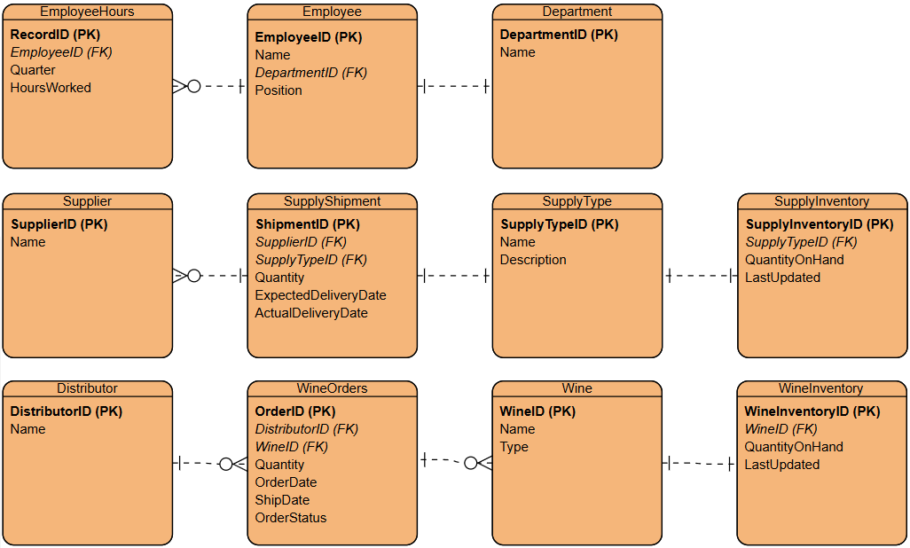
Finalized ERD

Slide 6
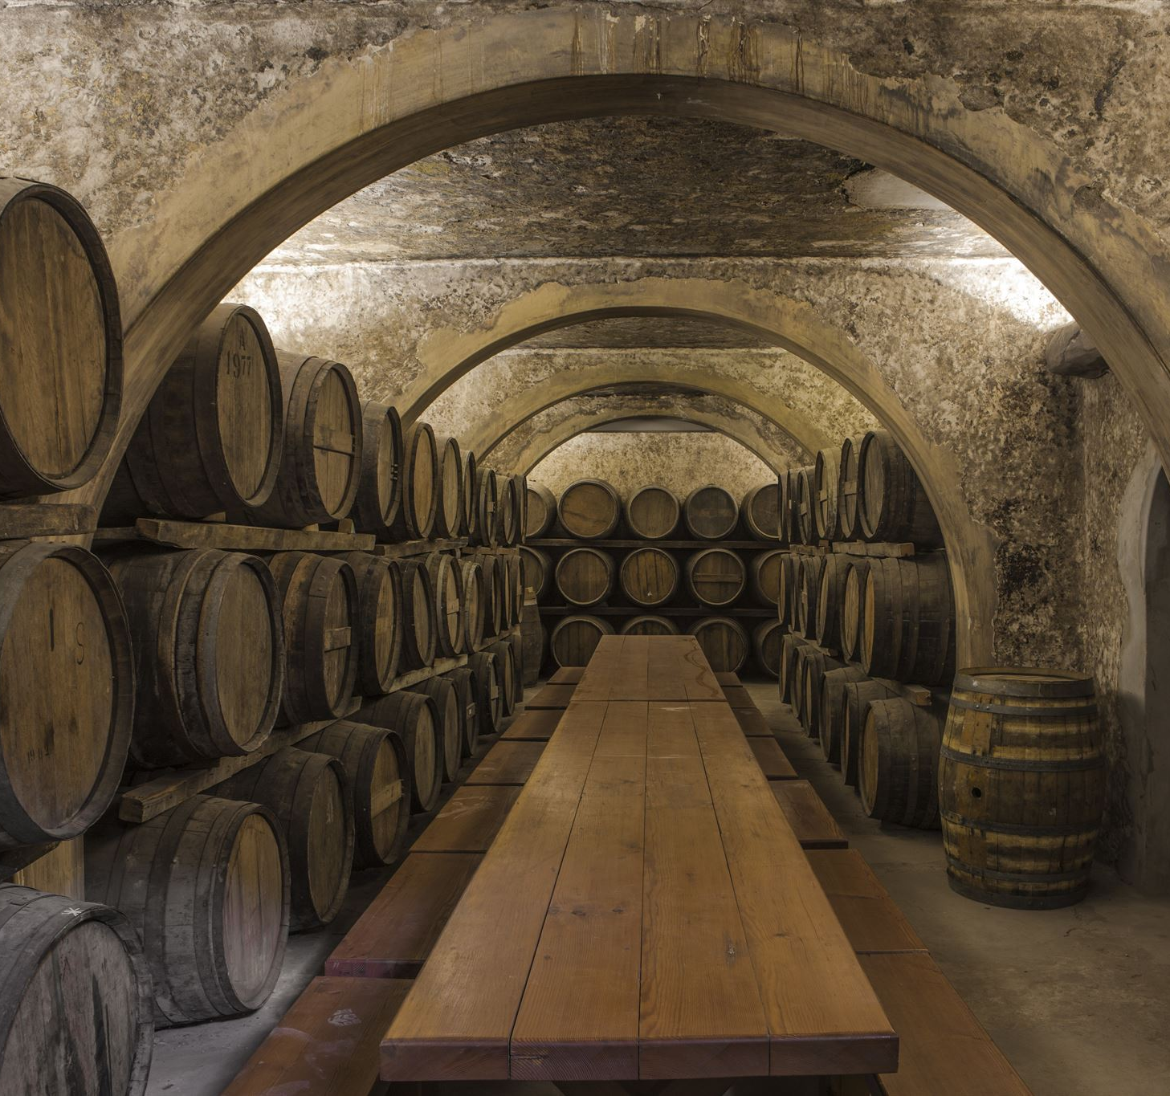
Business Reports
Generated using a custom Python script connected to the winery database
Executes SQL queries and outputs results to text files
Reports cover:
Wine Orders
Low Supply Inventory
Employee Weekly Hours
Aid in informed decision-making
Screenshots of each report follow

Slide 7
Pending Wine Orders Report
Lists all orders with Pending status
Tracks distributor, wine, quantity, and order date
Helps prioritize and follow up on outstanding orders
Filename: bacchus_pending_wine_report.txt
Criteria:OrderStatus = 'Pending’
Fields: Distributor, Wine, Quantity, Order Date
Distributor | Wine | Quantity | Ordered On
Grapes Galore | Merlot | 100 | 2025-04-10
Grapes Galore | Cabernet | 200 | 2025-04-03

Slide 8
Low Supply Inventory Report
Flags items with less than 100 units on hand
Supports proactive reordering
Includes supply type and current quantity
Filename: bacchus_low_supply_inventory_report.txt
Criteria: QuantityOnHand < 100
Fields: Supply Description, Quantity On Hand
Supply | Quantity On Hand
Bottles | 80
Tubing | 90

Slide 9
Employee Weekly Hours Report
Summarizes hours worked by each employee per week
Utilization analysis
Helps with payroll, staff planning
Filename: bacchus_employee_weekly_hours_report.txt
Criteria: All weekly entries from EmployeeHours table
Fields: Employee Name, Week, Hours Worked
Employee | Week | Hours Worked
Janet Collins | 2025-04-28 | 40.00
Roz Murphy | 2025-04-28 | 38.00
Bob Ulrich | 2025-04-28 | 42.00
Henry Doyle | 2025-04-28 | 36.00
Maria Costanza | 2025-04-28 | 39.00

Slide 10
Assumptions
Shipments & Inventory
Track expected vs. actual delivery dates for monthly delay analysis
Supplies (e.g., bottles, corks) are categorized by type and supplier
Enables inventory tracking and smart reordering
Wine Sales & Distribution
Sales data logged by wine type and distributor
Supports performance analysis and informed decisions
Distribution maps wine availability by distributor
Enables online ordering and shipment tracking
Employee Time & Departments
Employee hours tracked digitally or manually
Quarterly labor reports by employee and department
Departments (Finance, Marketing, Production, Distribution) have measurable, role-based operations
Business Intelligence
Stan and Davis access centralized business data
Focus on digitizing manual processes
Goal: Enhance timely reporting and decision-making

